Slide 1
Group 5: IoTrash

Slide 2
Introduction
1

Slide 3

What is IoTrash?
Solves the problem of an overflowing trash can
Measures the capacity of a trash can as it’s being filled up
Keep track of public trash can
Notes:
WHat is iotrash. Our device is the solution to overflowing trash cans
It measures the capacity of a trash can as it’s being filled up
THIS DEVICE CAN BE AN ESSENTIAL TO PUBLIC PLACES AS IT can measure public trash cans regularly for sanitary reasons

Slide 4
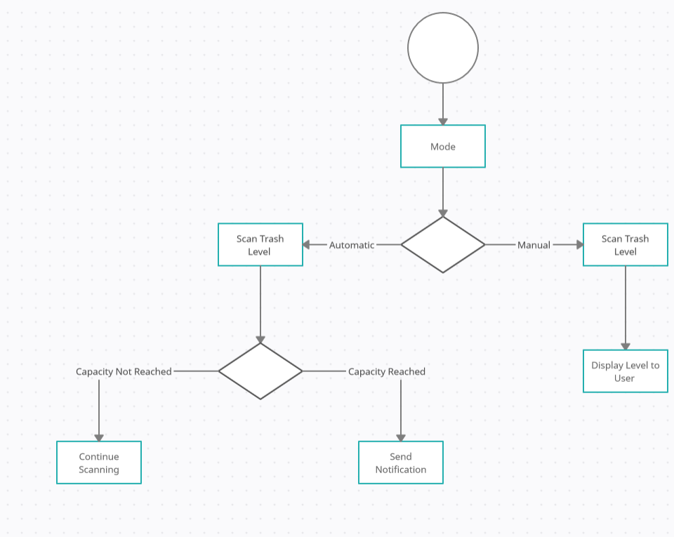
Notes:
Looking at the workflow you can see that our model follows an automatic mode which detects your trash can capacity at intervals and notifies you accordingly and manual mode which essentially lets the user check the capacity of the trash with the help of the app

Slide 5
Architecture
2

Slide 6
Overall Architecture
Level Specification
Functional View Specification

Slide 7
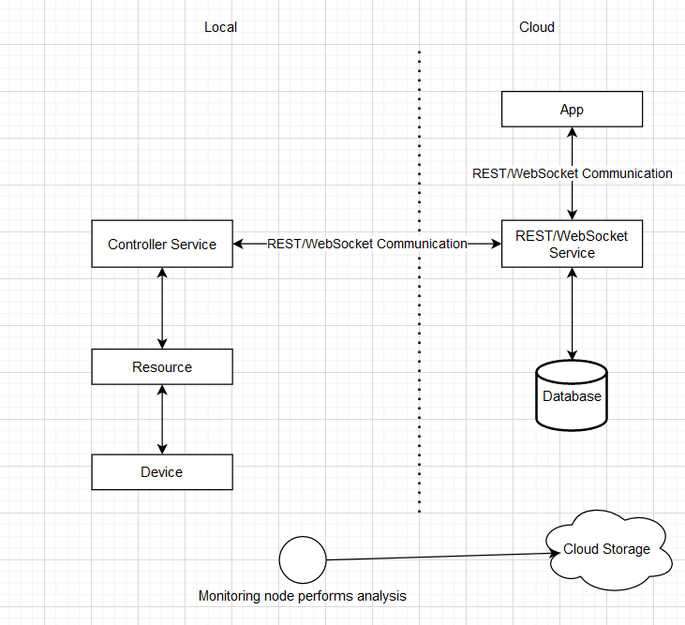
Notes:
Our project fall under the category of a level-1 IoT system. This means that we have a single sensor and device which senses and stores data and hosts the application
We chose a level-1 IoT system because our device is relatively low-cost and low-complexity. The data which we store and analyze is not too big and the analysis requirements are not computationally intensive.

Slide 8
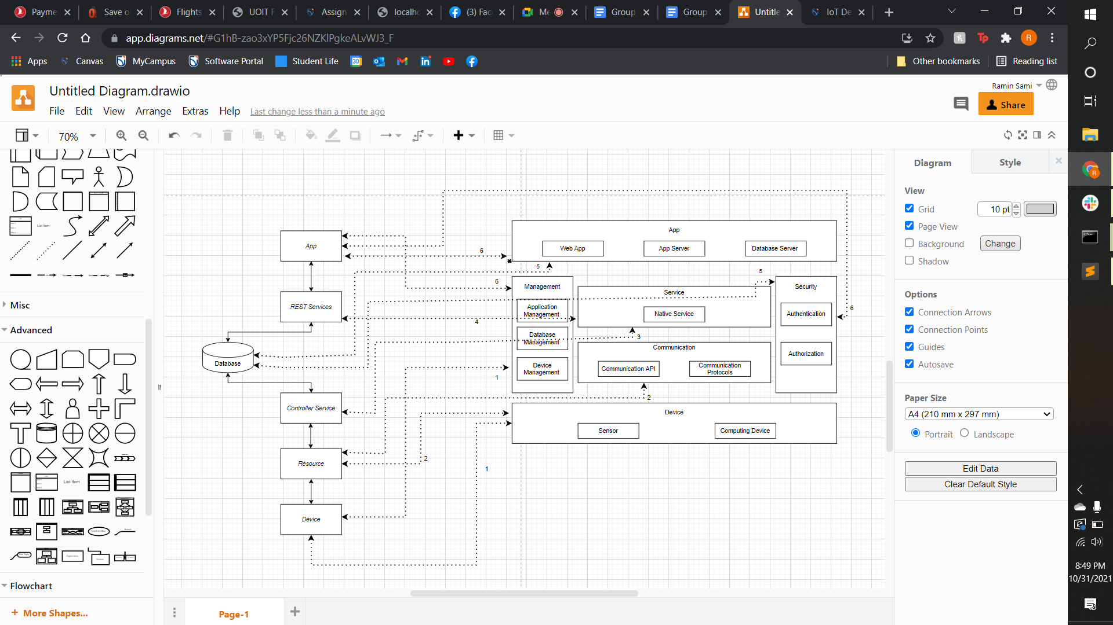
Notes:
Application is connected to the sensor and computing device (which is our NodeMCU microcontroller)
Resources map to the communication APIs and protocol
Database maps to sqlite management system and Database Security
Application maps to our Web App, App Server, and the Database Server, It also links to App Security

Slide 9
Design Decisions
3

Slide 10
Design Decisions
Ultrasonic Sensor
Measures distance using ultrasonic sound waves
Uses transducer to send/receive electronic pulses
Determines how filled a trash can.
NodeMCU
Base controller
Connected to online broker
Temporary stores values before publishing to broker
Power
Battery does not last long is an ESP8266 board
Deep-sleep mode implemented to save power
Notes:
Ultrasonic sensors work by sending out a sound wave at a frequency above the range of human hearing. It sends an ultrasonic pulse out at 40kHz which travels through the air and if there is an obstacle or object, it will bounce back to the sensor.
They are used primarily as proximity sensors.The reason for using them is that they are sometimes used as level sensors to detect, monitor, and regulate liquid levels in closed containers. tHat is essentially wat we were aiming for for our device where it can determine how filled a trash can is
NodeMCU Wifi-Module is the base controller. Connects to both the sensors and the online broker. We use it mostly to temporarily store the ultrasonic sensor values before publishing it to the broker
We used NodeMCU mostly because we had experience using it, same with the ultrasonic sensor
Only the Real time clock (RTC) consumes power during the deep sleep mode and everything else is powered off. The ESP8266 has a built-in timer (RTC). Through the crystal oscillator in the module, the RTC keeps track of time

Slide 11
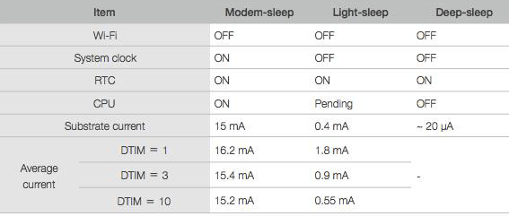
Power
Notes:
Shows the power usage between the 3 different sleep modes with the Real Time Clock
Uses 18650 batteries

Slide 12
Demonstration

Slide 13
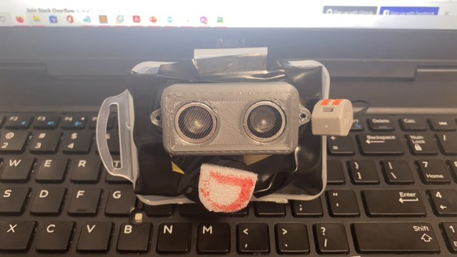
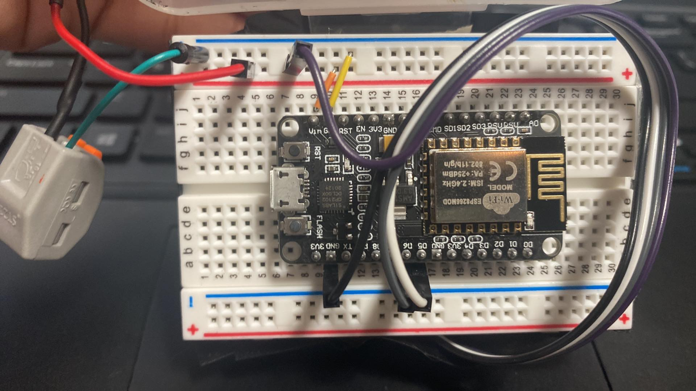
Challenges
Interface
Django Framework
DigitalOcean
WebSockets
NodeMCU
NodeMCU burned out
Twice
Sensor burned out
Once
Notes:
Couldn’t connect Django to MQTT broker (tried using paho MQTT but we were unable to map out to our application, so we could get the data but were unable to tie it in to our application)
We were using websockets and we ran into some issues when our NODEMCU burnt out so we got another nodemcu which then burned out the second time as well along with our sensor
How we were gonna use the websockets: When we get data from our backend it’s saved to a database and then we use a websocket to display that data to a user (essentially cuts out the middleman (Django))
Amin: We werent able to do live demo but we have screenshots of working code

Slide 15
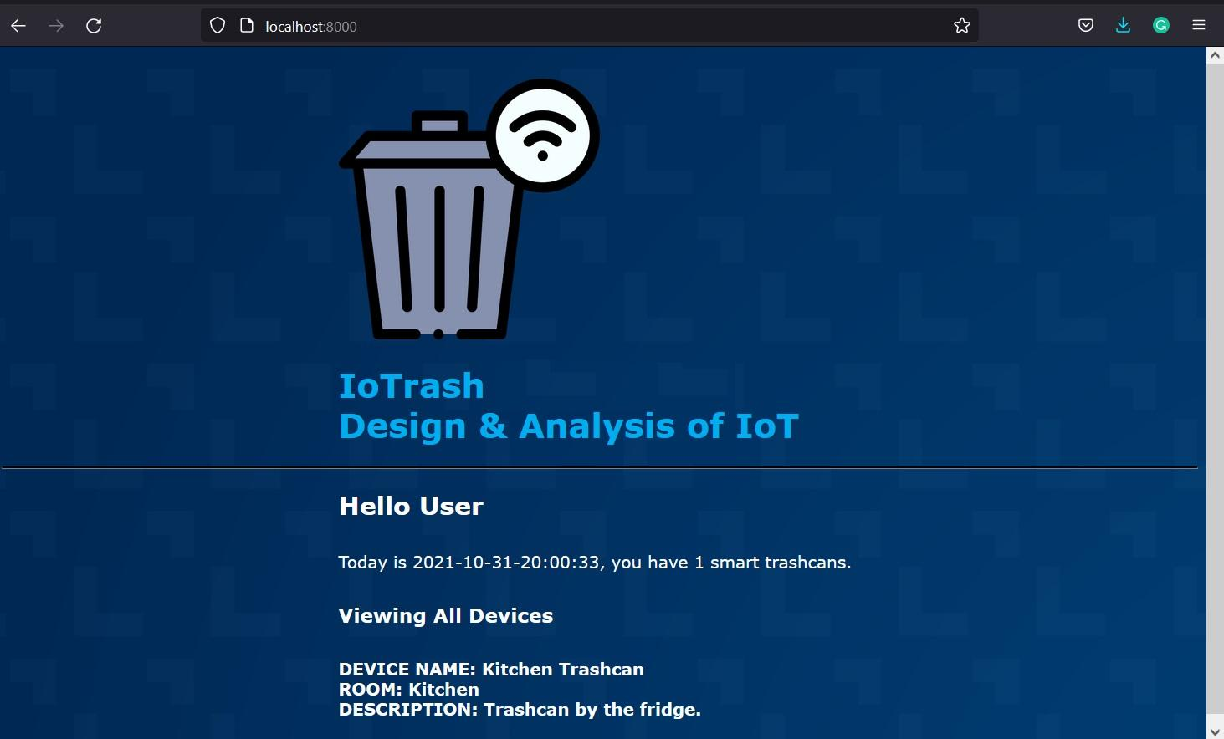

Slide 16
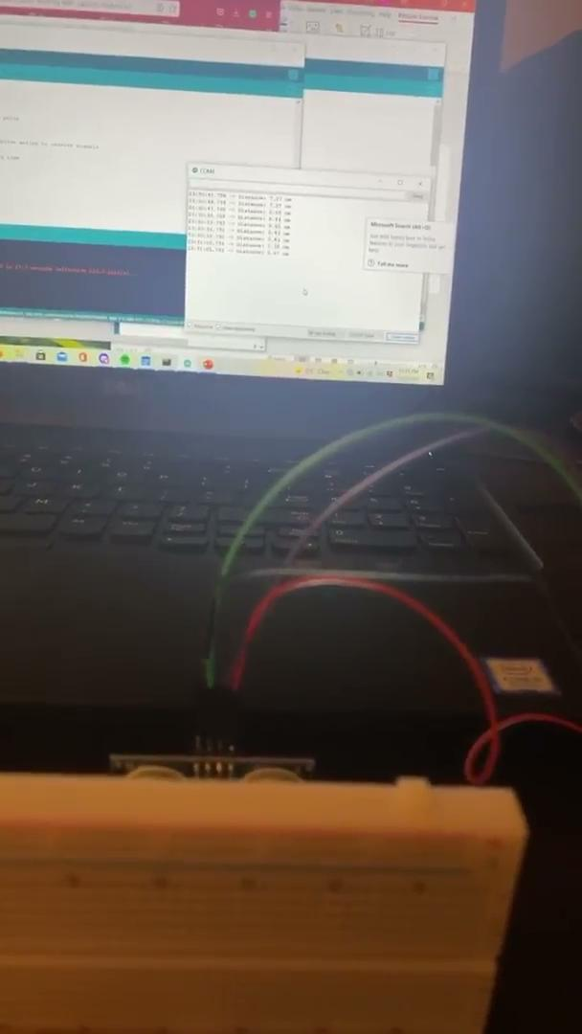

Slide 17


Slide 18
Thanks!
Any questions?

